Slide 1

Mortgage Borrowing Patterns in East Asians
Data Analysis and Story Telling Using Tableau Dashboard Home Mortgage Disclosure Act (HMDA) Data
Jasmine Kim
Open Avenues

Slide 2


East Asians Characteristics
Chinese, Japanese, Korean

Slide 3
East Asian Career Choices
Careers in STEM field: “According to the U.S. Census Bureau, the majority of Asian Americans are professionals in science and technology fields, and are not as well represented in production, entertainment, social services and humanistic fields.” (Ip, “Trends and Reasons behind Asian American Professional Choices”)
Reverence to education (Koh, “The 10 Values That Undergird East Asian Strength and Success”).

Slide 4
Ethnic Enclave
Ethnic enclave: “ethnic communities that have a well-developed economic structure that operates mainly through racial/ethnic dynamics” (Asian Nation, “Ethnic Communities & Enclaves”)
Sense of familiarity and emotional comfort as immigrants.
Lower language barrier.
Better adjustment of life in United States
Major cities: New York City, Los Angeles, Chicago

Slide 5
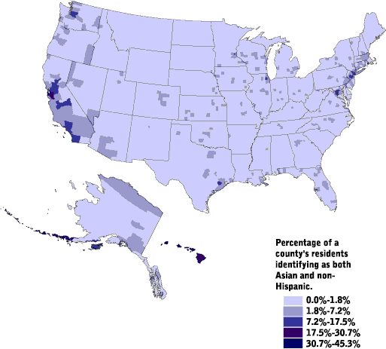
Asian Americans as a Percentage of total Population per County, 2000 CensusScope/Social Science Data Analysis Network

Slide 6
Property Values in Ethnic Enclaves
New York, California, and Washington was within the top four states with the highest home prices (Biermeier & Allen “15 States with the Highest Highest Average Home Prices”)

Slide 7

Tableau Dashboard
East Asians' Borrowing Patterns for Home | Tableau Public

Slide 8
Tableau Dashboard…Question
East Asians’ income on the graph correlates to the that of their popular STEM career choices
East Asians pay the highest amount of property cost
East Asians pay the highest mortgage interest rate
Q. Why do they pay the highest interest rate? Could it be the result of unfair lending by the financial institutions? Or is it due to East Asian characteristics?

Slide 9
Reason 1: Conventional Loans
Conventional loan is often the most expensive loan type among the four loans.
It requires a good amount of down payment and good credit score.
East Asians’ career choice in STEM may deter them from joining the military or own a farm. Thus, many of them will not qualify for VA loan or the loan for the farm owners.
East Asians may not be taking advantage of the FHA loan.

Slide 10
Reason 2: Ethnic Enclaves and Property Value
East Asians’ popular cities such as New York and Los Angeles have one of the highest property values along with high interest rates

Slide 11
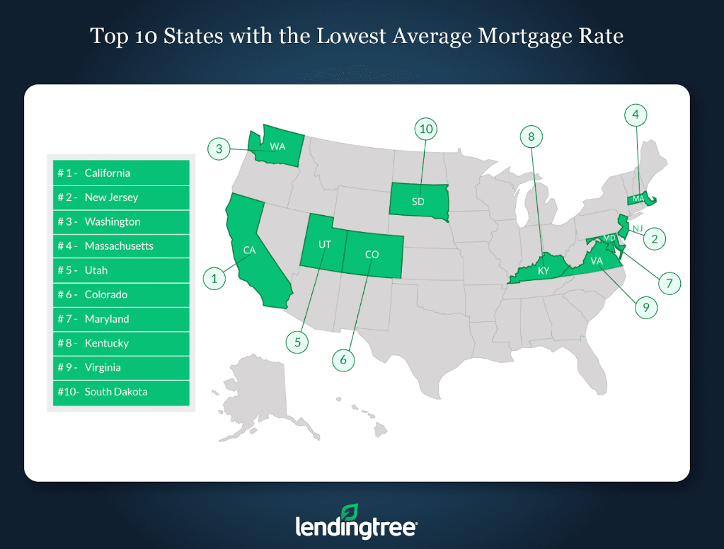
(Kapfidze, “Lending Tree Compares Mortgage Rates by State”)

Slide 12
Reason 3: Credit Score
Low credit history is the highest reason for denied mortgage application. This shows that East Asians may struggle with credit.
The income of those who were denied due to credit history is relatively close to the other races.
East Asians may not be aware of FHA loan that requires lower credit score.
Lending institutions may not be giving them more option and education about the different types of loans.

Slide 13
Conclusions
East Asians pay high interest rate…
East Asians’ career choices may not open them up to other types of loans.
East Asians’ ethnic enclaves populate around the states with the high interest rates and property costs.
East Asians, especially those with lower credit scores, may not be taking advantage of various types of loans such as FHA.
Lending institutions could offer more various loan types to East Asians.

